Slide 1

Modern life and technology

Slide 2
SPEAKING 1. Make a short list of technological breakthroughs (in the 21st c.) that solved huge problems and made our life easier.

Slide 3
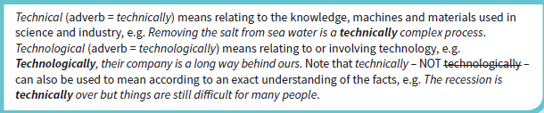
2. Complete the word beginning with ‘tech…’ in each sentence.

Slide 4
.
1. Karl got a good job as a lab tech ________ in the university.
2. In this country, young people tech________ become adults at the age of 18.
3. Computer tech_______ makes huge advances every year.
4. Andrea has a very interesting tech_______ for remembering vocabulary.
5. Publicity photos of celebrities have usually been tech__________ enhanced.
nician
nically
nology
nique
nologically

Slide 5
VOCABULARY 1. There are four words in each box and one of the words does not match with the rest of the group. Find the odd words.
A) derive, originate, come from, depart
B) exterminate, eradicate, elate, eliminate
C) shoot up, spur, stir, stimulate
D) galvanize, motivate, provoke enrage
E) fragility, sensitivity, brittleness, frailty
F) redirect, divert, divide, channel
G) supernatural, transcendent, metaphysical, mundane
H) vital, viable, feasible practical

Slide 6
LISTENING 1. Decide which groups of words from exercise 2 could fit into the gaps in the parts of the TED talk’s transcript.
• They didn't bring much back: 841 pounds of old rocks, and something all 24 later emphasized -- a new sense of the smallness and the ……………………………………………. of our common home.
• At the time, the strongest emotion was of wonder at the ……………………………………………. powers of technology.
• In the middle years of the century, polio was ……………………………………………. and smallpox eliminated Can technology solve our big problems?
• It feels as if technologists have ……………………………………………. us and enriched themselves with trivial toys
• Today, less than two percent of the world's energy consumption ……………………………………………. from advanced, renewable sources.
• Now, technologists, business leaders and economists all basically agree on what national policies and international treaties would ……………………………………………. the development of alternative energy,
• […] we soon discovered there are many kinds of cancer, and it is only in the last 10 years that effective, ……………………………………………. therapies have come to seem real.
• There is no ……………………………………………. contest like the Cold War, no politician like John Kennedy who can heroize the difficult and the dangerous […]
fragility
transcendent
eradicated
diverted
derives
spur
viable
galvanizing

Slide 7
SPEAKING 1. Debate and discuss, in groups, the following statements.
1. Do you think that landing on the Moon was a breakthrough for technology evolution?
2. Would you like to see people landing on Mars and setting up a colony there. Is it more important than the problems on Earth?
3. Are making money and capitalism something that hinder the development of advanced technology?
4. Do you believe that Silicon Valley companies are becoming less transformational and new
companies are less inventive and more focused on short-term gains?
5. Why don’t we solve big civilization-wide problems nowadays?
6. Do people need such a dire stimuli like war to unite for one cause?
7. Do you disagree with the video and think that we are going in the right direction in terms of
technology advancement?
8. Can technology solve such big issues like lack of resources, hunger or education?

Slide 8
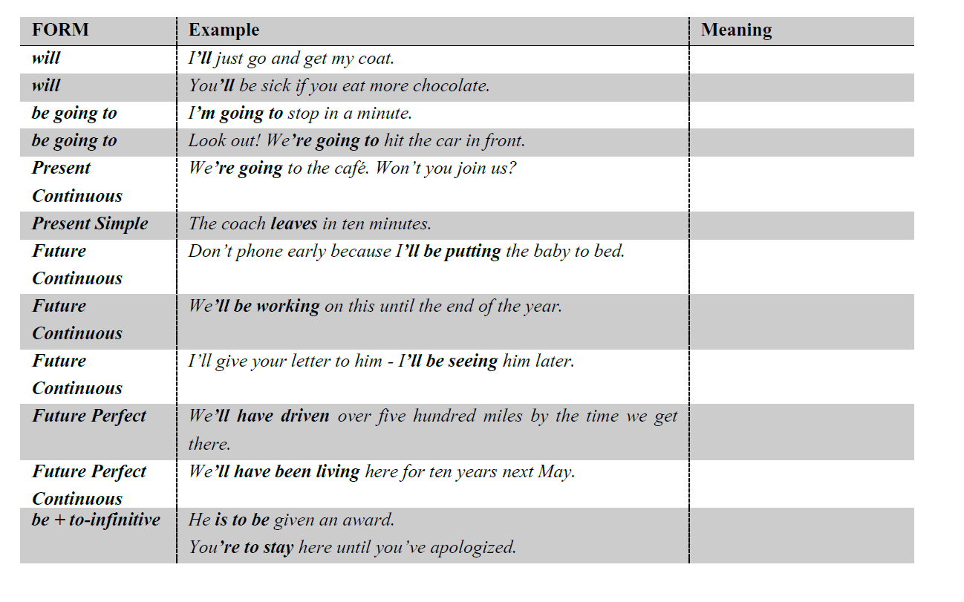
GRAMMAR 1. The table below summarises the different structures used to talk about the future. Match the meaning of each use to the appropriate sentence.

Slide 9
A an activity that will be happening during a period in the future
B a general prediction
C an official arrangement or order
D an action that will happen because it’s regular or decided
E a state of affairs in progress for a period up to a specified time in the future
F a personal intention
G an event that will be finished before a specified time in the future
H a prediction after looking at what is happening now
I an activity that will be in progress some time in the future
J an immediate decision about what you’re going to do
K fixed plans / arrangements
L an unalterable arrangement or fact

Slide 10
2. Choose the correct item.
1 “Any news from Dina?”
“Yes. She _____ tomorrow on the 9:15 train.”
A will have been arriving C arriving
B will have arrived D arrives
2 “I suppose your essay isn’t ready yet.”
“Don’t worry. I _____ it by tomorrow.”
A will have been finishing C am finishing
B will be finishing D will have finished

Slide 11
.
3 “So when is your maths exam?”
“Well, this time tomorrow, I _____ for it.”
A will be sitting C will have been sitting
B will sit D sit
4 “I first came here last June.”
“So by the end of May you _____ with us for almost a year.”
A will have been working C will have working
B will work D work
5 “So, are you coming along, after all?”
“Well, I don’t know. What time _____?”
A you’re leaving C will you leave
B will you be leaving D do you leave

Slide 12
3. Work in groups. Make predictions for 2035 for each of the following using the appropriate present / future tense. You can use some of the following words as starting point: develop, disappear, fade away, increase, enhance, replace, make into, take over.
1 computing power
2 interfaces
3 monitors
4 teleworking
5 money
6 shops
7 machine intelligence compared to human intelligence
8 the internet
9 keyboards
10 speech recognition

Slide 13

Thank you!

